Slide 1

Uncovering and adopting untapped
streaming consumers
Nicholas Thomas, nhthomas
Kelly McManus, kellymcm
Davidson Siga , dsiga
Krishnaraj Pawooskar, kpawoosk
Michael Yang, myang3
earmark
Notes:
Hi, I’m ___ this is the earmark team, and today we are going to discuss uncovering and adopting untapped streaming consumers.

Slide 2

(Telegraph, 2020)
Notes:
Now, as students, streaming is often something that we are all too familiar with. This screen might be something you’ve come across before.
The industry has been taking off with a few players since 2010…

Slide 3
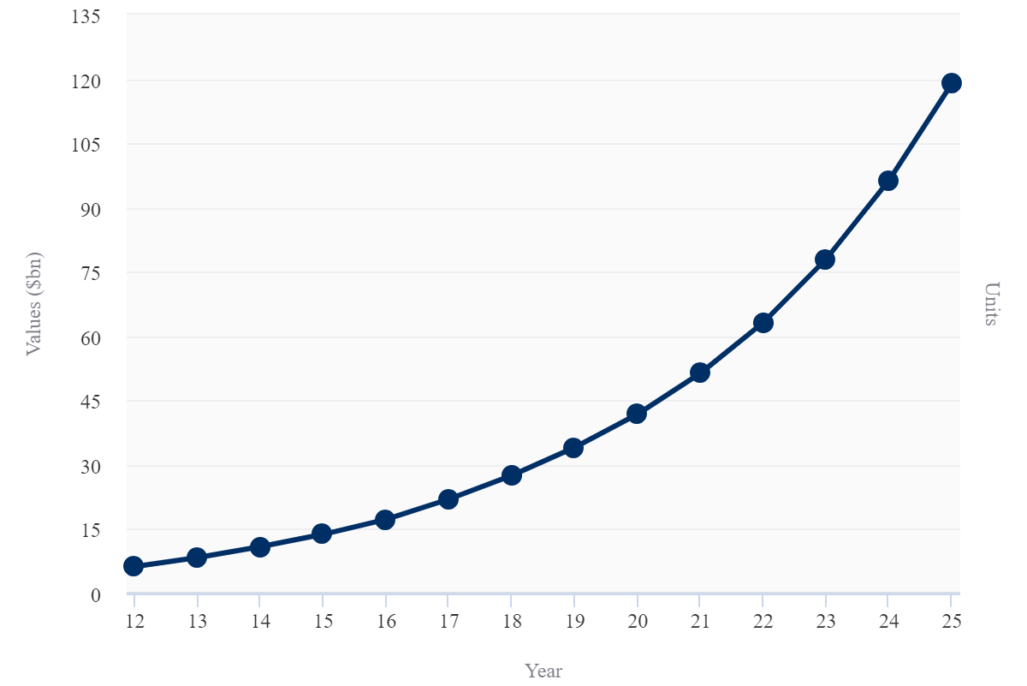
Year over year increase in market revenue
(Cook, 2020)
Notes:
In particular, streaming industry revenues have been increasing annually by 23.3% and are projected to continue rising.

Slide 4
Sleep is
our biggest competitor.
Reed Hastings, CEO, Netflix, 2017
(The Guardian, 2017)
Notes:
This growth led the Netflix’s CEO to claim in 2017 that “sleep” is their biggest competitor.

Slide 5
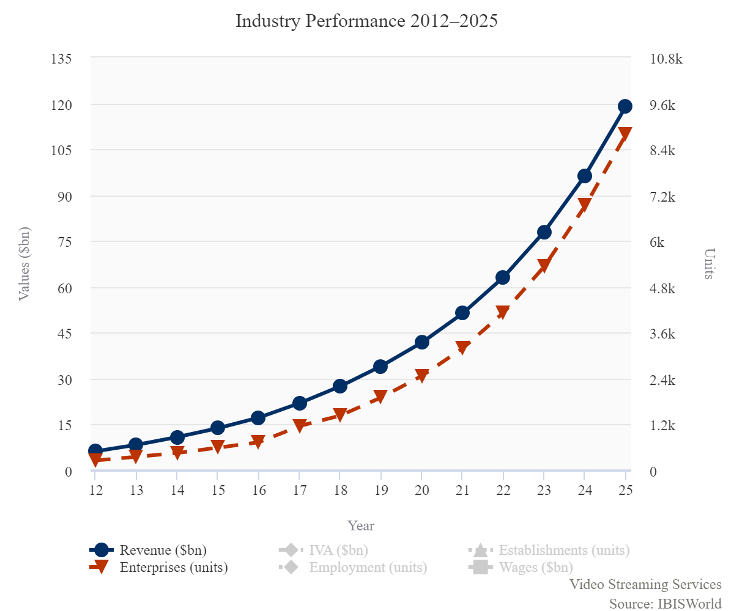
Year over year increase in enterprises
(Cook, 2020)
Notes:
However, this booming market has also attracted new entrants (shown by the red line) to carve out their own particular niches in streaming.

Slide 6



Streaming companies face stiff competition
Compete for consumer attention and subscriptions
Risk of redundant advertising
Increase costs of acquisition
Notes:
This has created a competitive landscape where companies are struggling to find new consumers who are not already loyal to a competing streaming service, take the risk of redundant and over advertising, and which all concludes to an increase in cost of acquisition.

Slide 7


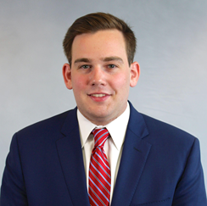

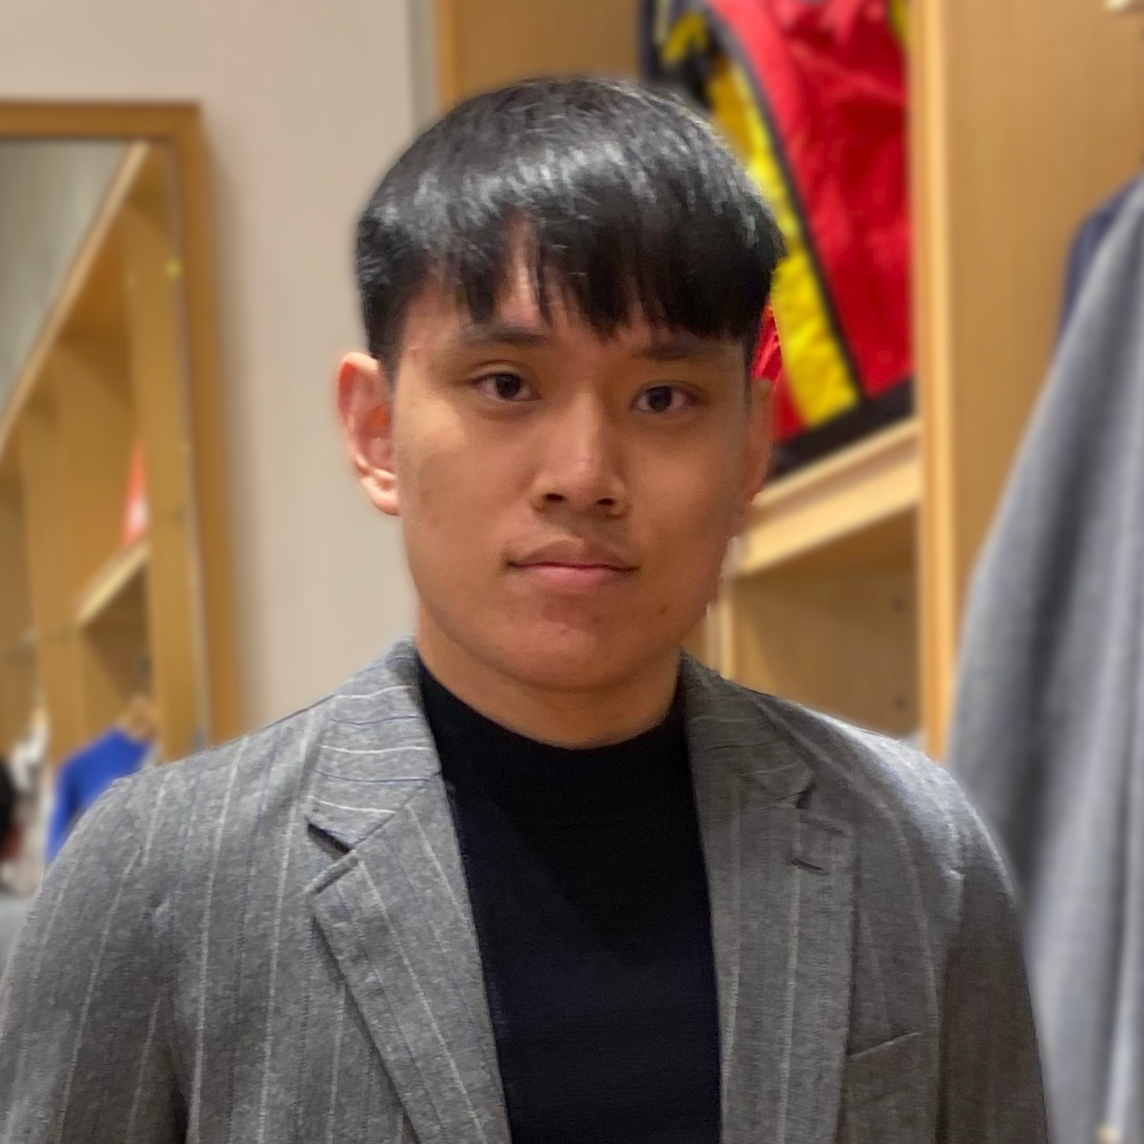

Team of experienced product and data scientists
Cole Thomas
LinkedIn Profile
MISM-BIDA (‘22)
4 years of experience at Wells Fargo Securities as an Analytics Consultant
Kelly McManus
LinkedIn Profile
MISM-BIDA (‘22)
3 years of product analytics at transportation startup, Bus.com
Michael Yang
LinkedIn Profile
MISM-BIDA (‘22)
2 years of experience as Analytics Consultant at Deloitte Consulting
Davidson Siga
LinkedIn Profile
MISM (‘22)
3 years of experience in Data Science in Healthcare and BFSI
At Mu Sigma and
Wells Fargo
Krishnaraj Pawooskar
LinkedIn Profile
MISM (‘22)
6-month experience as a Software Developer Intern at Robert Bosch
Notes:
Understanding this problem, our team of experienced product and data scientists came together to form …

Slide 8
earmark
Notes:
EARMARK. A business intelligence firm that focuses on listening to customers through surveys and open source data

Slide 9
Help streaming companies identify and advertise to high potential customers to increase ROI on advertising and market share.
earmark
Notes:
VALUE PROPOSITION:
…helps streaming companies identify and advertise to high potential customers to increase ROI on advertising and market share.

Slide 10
Is a user a streaming consumer or a potential lead?
Notes:
Our first model will be to predict if a user is already a streaming consumer or not.

Slide 11


Deloitte Media Consumption Survey Dataset
2009
Survey Data
2010
Survey Data
2011
Survey Data
Combined Dataset
Notes:
Survey data provided by Deloitte was the foundation of our product.
Our team analyzed and merged 3 different years of data to provide the most generalizable model possible
<a href="https://www.flaticon.com/free-icons/consolidation" title="consolidation icons">Consolidation icons created by Freepik - Flaticon</a>

Slide 12
Dataset Features
Over 190 survey data points
6,400+ rows
Demographic Data
Respondent media consumption habits

Slide 13
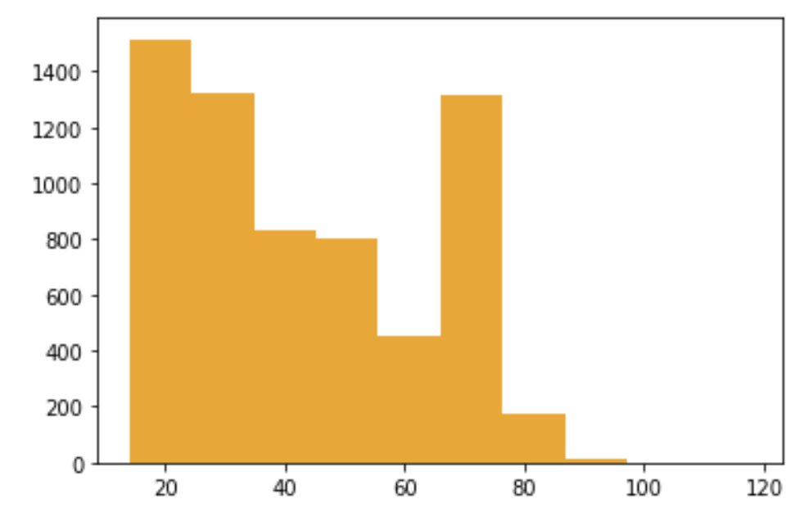
Demographic analysis
Age
Ethnicity
 | census.gov | Deloitte
White | 76.3% | 64-70%
Hispanic | 18.5% | 10-11%
Black | 13.4% | 10-13%
Asian | 5.9% | 2-7%
Notes:
In 2020, about 18.37 percent of the U.S. population fell into the 0-14 year category, 65 percent into the 15-64 age group and 16.63 percent of the population were over 65 years of age

Slide 14
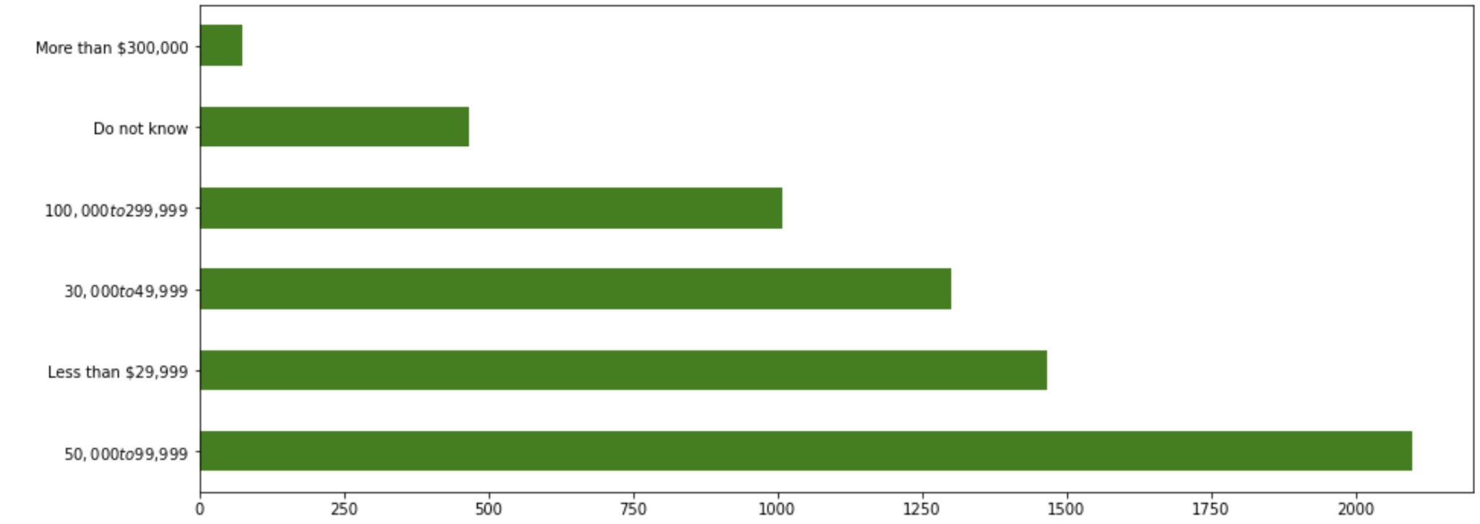
Demographic analysis
Income
Notes:
Key takeaways:
Reflects the US total population
Enables our team to build effective models across the domestic market
Risk: model risk when US demographics aren’t reflected

Slide 15
Demographic takeaways
Reflects US population
Enables modeling across domestic market
Risks poor performance where demographics aren’t reflected

Slide 16
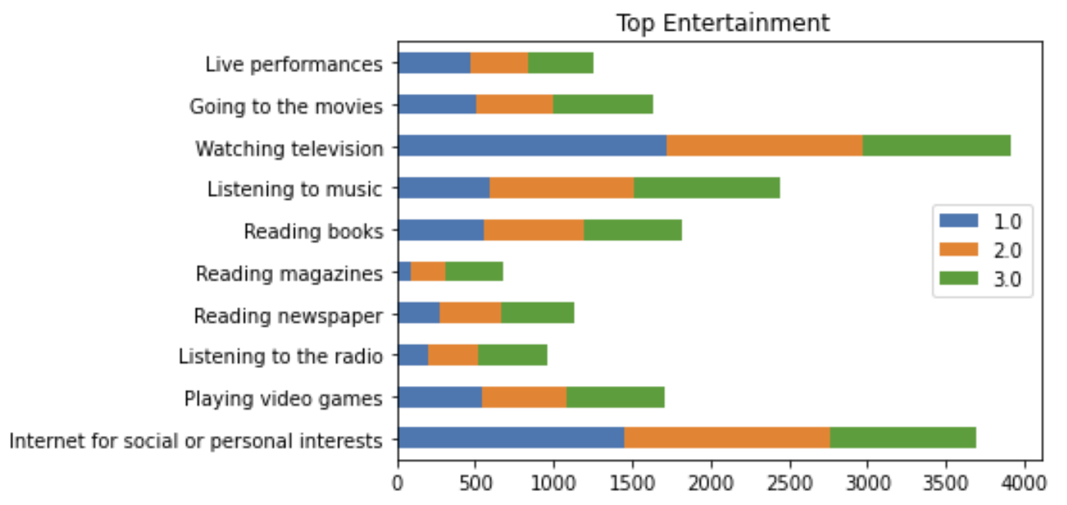
Top entertainment activities of respondents
Watching TV
Listening to music
Gaming
A
A
B
B
C
C

Slide 17
Target: Which services do you pay for?
→ Flag for consumer paying for streaming
→ Streaming = music, video, or gaming

Slide 18
Feature engineering & cleaning
Making sense of 195 variables.

Slide 19
Data leakage
Q11 - Of the products you indicated you own, which do you value the most?
→ Streaming?
Notes:
26 features - importance

Slide 20
Data leakage
Q11 - Of the products you indicated you own, which do you value the most?
→ Streaming?
Notes:
26 features - importance

Slide 21
Feature Engineering: Recategorizing
Q8 - Which of the following media or home entertainment equipment does your household own? Flat panel television
Q8 - Which of the following media or home entertainment equipment does your household own? Digital video recorder (DVR)
Q8 - …
High Tech | 'Smart watch’, ‘Fitness band’, ‘Smart glasse’, ‘Virtual reality headset’, ‘Drone' | Binary Flag
Low Tech | 'Antenna’, ’Basic mobile phone'
Notes:
26 features - importance

Slide 22
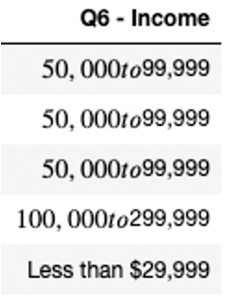
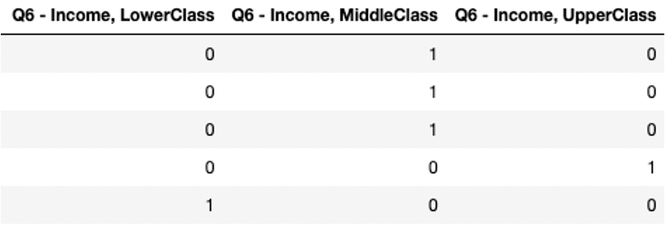
Feature Engineering: One Hot-Encoding & Bucketing
Notes:
The combination narrows the 198 features to 40
Maybe do the funnel thing to explain the biz logic

Slide 23
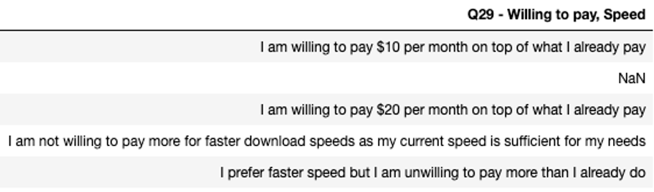
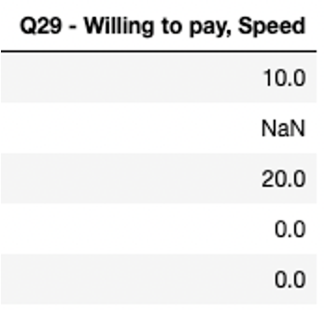
Feature Engineering: Numeric
Notes:
The combination narrows the 198 features to 40
Maybe do the funnel thing to explain the biz logic

Slide 24
Feature engineering + Data leakage removal +
Outlier treatment+ Missing value treatment → 26 clean, high impact features
Ready for modeling!

Slide 25
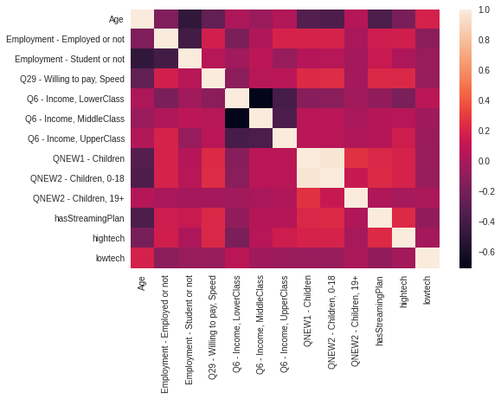
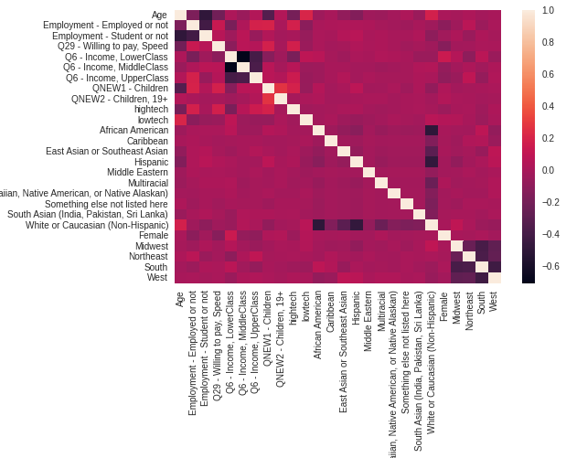
Impact of Feature Engineering! (Before vs After)
Notes:
We can visually see that feature engineering has really helped us remove those extremely white spaces!

Slide 26
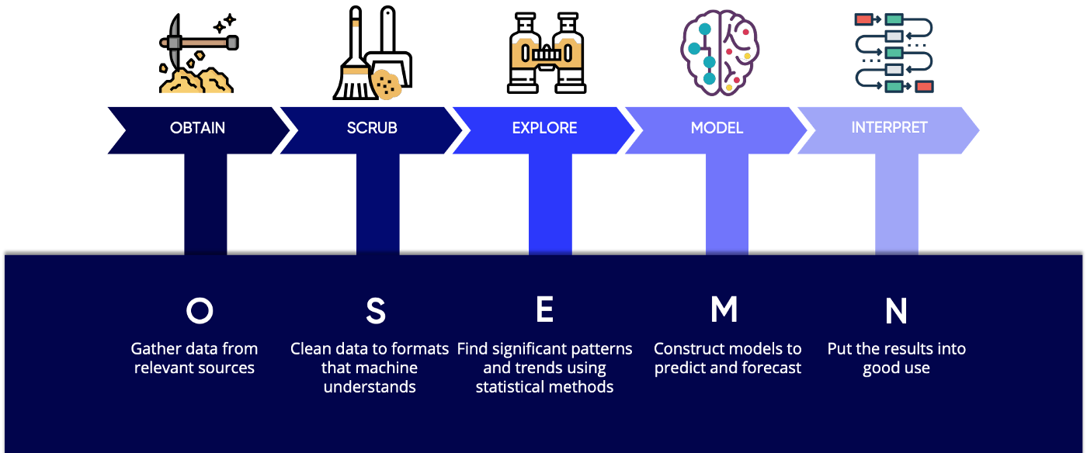
Our experienced leadership builds SOTA Data Science pipeline
[1] : Lau, D. C. H. (2019, January 10). 5 steps of a data science project lifecycle. Medium. ]Retrieved February 28, 2022, from https://towardsdatascience.com/5-steps-of-a-data-science-project-lifecycle-26c50372b492
Notes:
Thanks Michael!
With the right data transformation we are able to get best results on fitting the data into Machine Learning Models!
Our team of experienced data scientists in collaboration with industry leading product managers has build a state of the art Machine Learning Pipeline.
Our focus now shifts into the Modelling and interpretation stages of the pipeline.

Slide 27
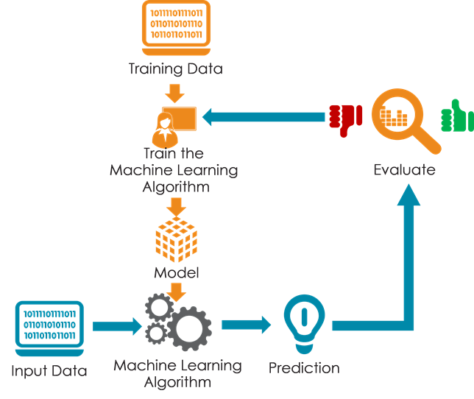
The Engineered data was modelled with reliable ML Algorithms
[2]: Modeling the data - data science tutorial. Intellipaat Blog. (n.d.). Retrieved February 28, 2022, from https://intellipaat.com/blog/tutorial/data-science-tutorial/modeling-the-data/ [3] Grid search hyperparameter tuning with scikit-learn ( GRIDSEARCHCV ). PyImageSearch. (2021, May 7). Retrieved February 28, 2022, from https://pyimagesearch.com/2021/05/24/grid-search-hyperparameter-tuning-with-scikit-learn-gridsearchcv/
Notes:
This industry standard approach towards building a model is used.
We train,validate and evaluate the machine learning model on our engineered data.

Slide 28
Explore two classification ML algorithms in hypothesis space
Logistic
Regression
Random
Forest
Notes:
We chose to explore couple of ML algorithms to build the best classifier on the target of whether a digital consumer is a streamer or not.

Slide 29
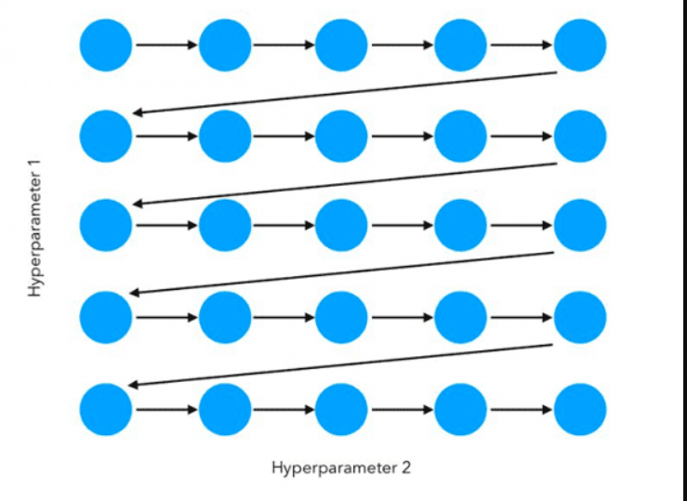
Hyperparameter tuning with Grid Search
[2]: Modeling the data - data science tutorial. Intellipaat Blog. (n.d.). Retrieved February 28, 2022, from https://intellipaat.com/blog/tutorial/data-science-tutorial/modeling-the-data/ [3] Grid search hyperparameter tuning with scikit-learn ( GRIDSEARCHCV ). PyImageSearch. (2021, May 7). Retrieved February 28, 2022, from https://pyimagesearch.com/2021/05/24/grid-search-hyperparameter-tuning-with-scikit-learn-gridsearchcv/
Notes:
We took the modelling approach a step further by grid searching on the model hyperparameters space.
Let us now look at the outcomes

Slide 30
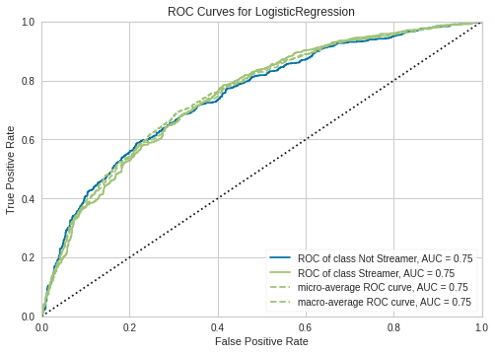
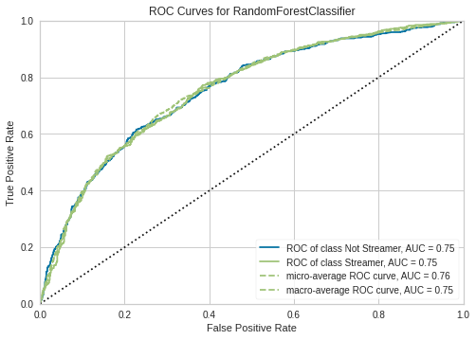
Evaluating best model with ROC
Notes:
The ROC curves and AUC values are the industry standards to evaluate a classification model.

Slide 31

Evaluating best model with ROC
Notes:
Both the grid searched models are really close wrt these metrics.But random forest wins by a small margin.
To reinforce our selection we also look at the classification report

Slide 32
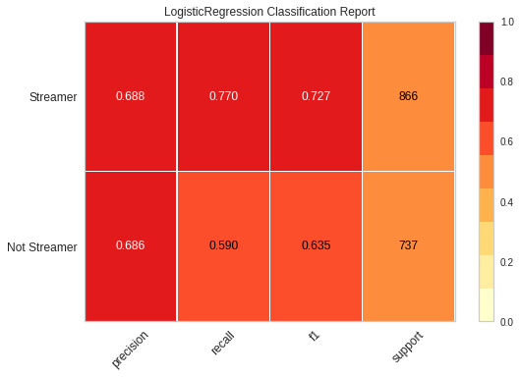
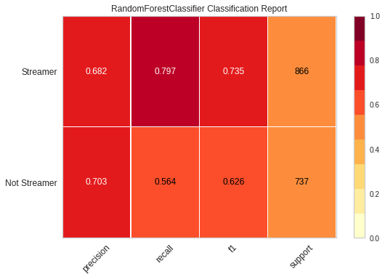
Evaluating best model with Confusion Matrix
Notes:
We look at Recall and F1 scores as we want our model to predict as less incorrectly as possible.

Slide 33
Evaluating best model with Confusion Matrix
Notes:
Random Forest does marginally better than logistic regression in that aspect too!

Slide 34
Use best model to interpret data
Logistic
Regression
Random
Forest
Notes:
Hence we use Random Forest to model and interpret the importance of our data.
Let’s look at what factors are the most important in determining whether a digital consumer is streamer or not

Slide 35
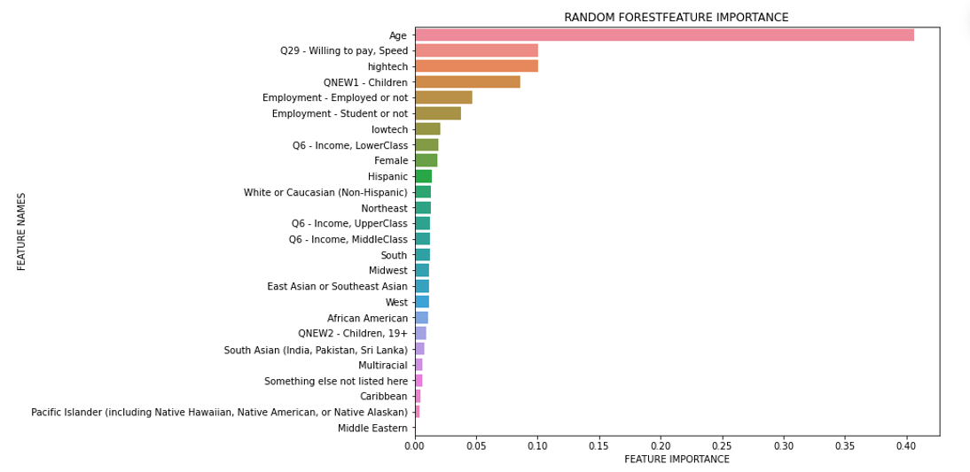
Feature engineering helped identify impactful features!
Notes:
On thing to notice is that our feature engineering has been very successful and they run to the top of this list!

Slide 36
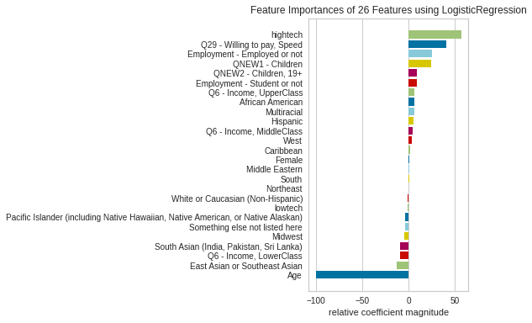
Feature importance vs sign of coefficient
Notes:
Same applies to the outputs of logistic classifier.
These were the findings of our approach so far, Krish will take you through the Insights and recommendations.

Slide 37
Impacts a streamer’s decision? (Magnitude)
Likely to stream when:
Regularly use high-tech equipment
Willing to pay for bandwidth
Age, below age 40
Notes:
Random Forest feature importance , we see that
Drones, gaming pc, video rec dev

Slide 38
Impacts a streamer’s decision? (Direction)
Likely to stream when:
Regularly use high-tech equipment
Willing to pay for bandwidth
Age, below age 40
Notes:
Logistic classifier feature importance.
We are able to identify the directionality of the feature’s impact through our work with logistic classifier.
But how do these insights help?

Slide 39
What does this mean for streaming companies?

Slide 40




Recommendation: Promote premium with loyal streaming
“High tech” individuals
Age less than 40
Individuals willingness to pay for faster internet speed
Households with children less than 19 years old
Notes:
Cater content improving their experience

Slide 41



Recommendation: Target untapped consumers & improve value
Expand into untapped segments Partner with educational institutions
Improve streaming value in consumers life
Notes:
40-60 aged (daily news, retro music and classics)
Promote Online learning
Recurring value by diversifying content types to be a part of peoples everyday lives.
Streaming is being extensively used and so Instead of being a disposable service, it can be made to have recurring usage by bringing a variety of content types.

Slide 42



Next steps
Predict premium consumers
Expand model to new markets
Add data sources & continuously improve feature engineering
Notes:
Additional Models - Predicting premium, further narrowing high potential consumers
Expanding portfolio - Other relevant earmark’s markets (give examples)
Better Data Engineering : Improving & Integrating additional Data Sources

Slide 43
References
Cook, D. (2020, November). Video Streaming Services in the US: US Specialized Industry Report OD6197. IBISWorld. https://my-ibisworld-com.cmu.idm.oclc.org/us/en/industry-specialized/od6197/about
Hern, A. (2017, April). Netflix's biggest competitor? Sleep. The Guardian. https://www.theguardian.com/technology/2017/apr/18/netflix-competitor-sleep-uber-facebook
Telegraph. (2020, September). Why Netflix Asks “Are You Still Watching?” (and How to Stop It). https://techtelegraph.co.uk/why-netflix-asks-are-you-still-watching-and-how-to-stop-it/
Lau, D. C. H. (2019, January 10). 5 steps of a data science project lifecycle. Medium. ]Retrieved February 28, 2022, from https://towardsdatascience.com/5-steps-of-a-data-science-project-lifecycle-26c50372b492
Modeling the data - data science tutorial. Intellipaat Blog. (n.d.). Retrieved February 28, 2022, from https://intellipaat.com/blog/tutorial/data-science-tutorial/modeling-the-data/
Grid search hyperparameter tuning with scikit-learn ( GRIDSEARCHCV ). PyImageSearch. (2021, May 7). Retrieved February 28, 2022, from https://pyimagesearch.com/2021/05/24/grid-search-hyperparameter-tuning-with-scikit-learn-gridsearchcv/

Slide 44
ARCHIVE:We hear you! And We recommend the best for you!
Helping you identify your best market!
Tagret hightech communities (fitness/drones/3d printing) (MODEL OUTCOME)
People with children and children>19 yo are highly plausible streamers (MODEL OUTCOME)
Willingness to pay for higher internet indicates interest in higher quality experience in streaming(MODEL OUTCOME)
Ability to pay and Income class directly affecting the ability to be a streamer, hence we need to incentivise these customers to be able to access the services(MODEL OUTCOME)
Helping you identify the future disruptors!
Although people with higher age might not be into streaming, but this showcases an opportunity into the market of 40-60 year olds who could be an untapped market for streaming service (MODEL OUTCOME)
Need to bring value to streaming services instead of being a disposable service (EDA)
Opportunity to have students register for streaming services to cross sell through educational services (neflix could enter edtech) (MODEL OUTCOME)

Slide 45
Feature Engineering: One Hot-Encoding & Numeric
OHE & bucket: Income
Numeric: Willing to pay for internet speed
Notes:
The combination narrows the 198 features to 40
Maybe do the funnel thing to explain the biz logic

